Slide 1








CareBot
AI & Machine Learning Track

Slide 2
Zen Coders
YOGESH V
SUDHARSHAN V
THARUN V
SRINITHYA A

Slide 3
PROBLEM STATEMENT
Access to quality healthcare remains uneven, especially in remote or underserved areas. Patients often need help understanding symptoms and deciding whether they need professional care.

Slide 4

ABSTRACT
This project presents a patient-friendly AI-assisted telemedicine triage platform that processes symptom descriptions using NLP and machine learning. The system predicts urgency, applies red‑flag rule checks, and stores results securely in a local database. Designed for offline use, it ensures privacy, fast assessments, and timely recommendations for patients.

Slide 5
INTRODUCTION
Our platform empowers patients to describe symptoms in plain language through a simple web interface. Using FastAPI, spaCy, and scikit-learn, the system extracts medically relevant symptoms, analyzes urgency through AI and rules, and logs data in MongoDB, ensuring both accessibility and privacy in telemedicine triage.

Slide 6

PROPOSED SOLUTION
A web-based triage system with HTML/CSS/JavaScript frontend sends patient data to a FastAPI backend. NLP extracts symptoms, ML models assess urgency, and rule-based checks detect emergencies. MongoDB logs each case . This hybrid approach delivers quick, accurate, and private triage recommendations without relying on external cloud services.

Slide 7
TECH IMPLEMENTATION
POINT 1
POINT 2
POINT 3
Frontend: HTML/CSS/JavaScript form collects age and symptoms, sends request to FastAPI.
Backend:
FastAPI + spaCy + scikit-learn model processes symptoms, applies rule-based overrides.
Database:
MongoDB logs cases , results returned to frontend instantly.

Slide 8
KEY FEATURES
FEATURE 1
AI‑Driven Symptom Analysis – Uses spaCy NLP to extract symptoms and a scikit‑learn model with rule‑based checks to deliver fast, accurate triage.
FEATURE 2
Secure Local Storage – Saves all patient data in MongoDB, ensuring privacy, full data ownership, and offline functionality.

Slide 9
IMPACTS AND BENEFITS
Improves healthcare accessibility, enables early detection of critical conditions, and reduces hospital load by filtering non‑urgent cases. Provides patients with instant, clear guidance via a simple interface. The combination of AI predictions and medical rules ensures accuracy, while local storage guarantees privacy, security, and offline functionality.

Slide 10
NOVELTY
This platform uniquely combines AI-driven symptom extraction with rule-based emergency detection for enhanced triage accuracy. It operates fully offline with MongoDB storage, ensuring patient privacy. The patient-friendly web interface paired with a modular backend enables easy expansion and rapid deployment without cloud dependencies—ideal for diverse, low-resource settings.

Slide 11
TECH STACK
Built using Python with FastAPI for the backend API, spaCy for Natural Language Processing, and scikit-learn for machine learning. The frontend uses plain HTML, CSS, and JavaScript for accessibility. MongoDB provides secure local data storage. Joblib handles model saving. This stack ensures simplicity, privacy, offline capability, and ease of deployment.

Slide 12
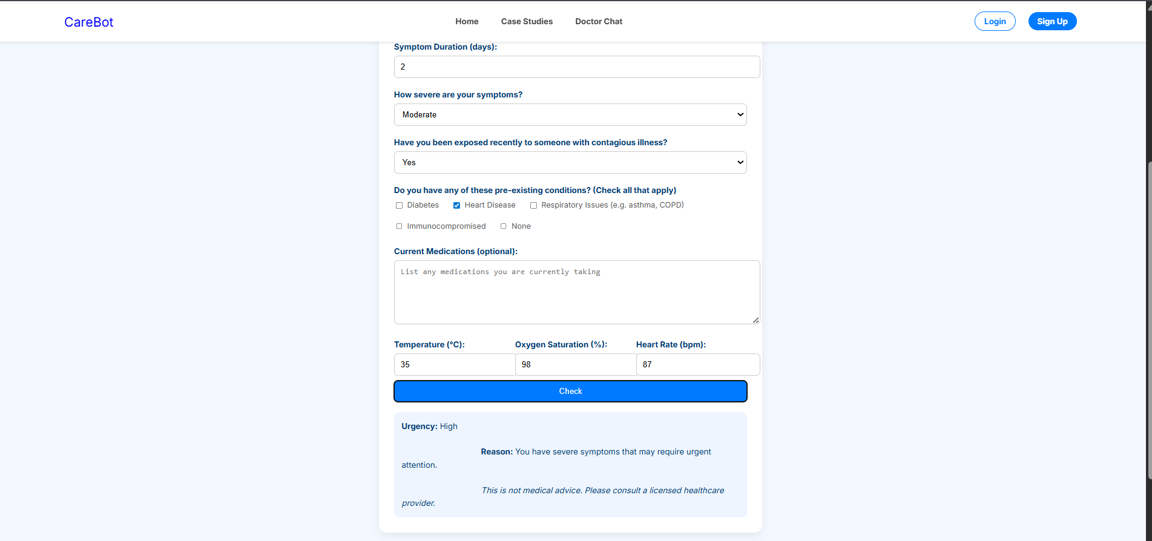
RESULT

Slide 13
THANK YOU

